Slide 1

cle advocacy
DIGITAL CREATIVE JOURNAL
PERFORMANCE TASK
Our honorable Christian Living Education teacher Mr. Rainheart Pinuela

Slide 2
MEMBERS INTRODUCTION:
Maekylla Labiste
Group leader
Comic Illustrator
Digital Journal editor
Mary Gold Millendez
Story writer
researcher
PRESENTATION FROM THE GROUP OF 11
9E 2021-2022 S.Y.

Slide 3
MEMBERS CONTRIBUTION:
What is a comic strip?
com·ic strip
/ˈkämik ˌstrip/
noun
a sequence of drawings in boxes that tell an amusing story, typically printed in a newspaper or comic book.
Trina Lynn Gonzales
assistant story writer
co-comic illustrator designer
Josh Momville
comic illustrator planner and designer

Slide 4


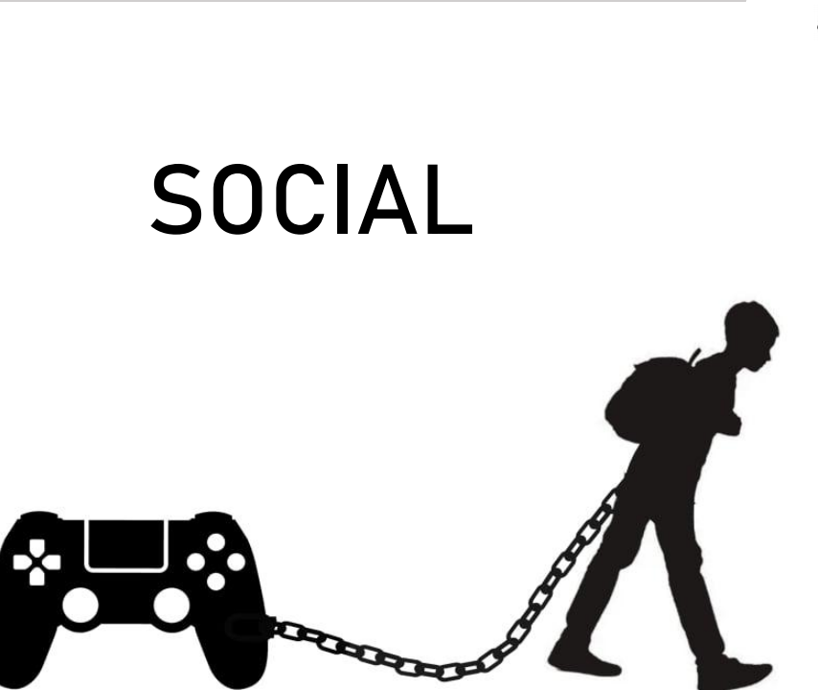


Slide 5
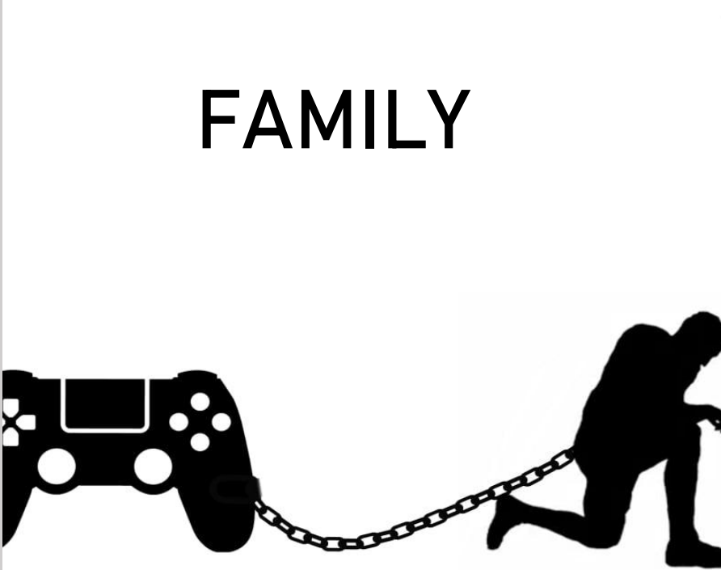

What is the comic strip about????

Slide 6

COMIC STRIP Online Gaming Addiction Advocacy
We created a comic strip to emphasize the significance of continuing to hold on to one's religion and Christian family values. We also consider this as a call from God to spread awareness and help those who are lost not go astray.
ONLINE GAMING ADDICTION IS UNHEALTHY!!!

Slide 7
What is online gaming?
An online game is a video game that is either partially or primarily played through the Internet or any other computer network available.
The reality is, consequences and suffering itself is an intervention
– by God.
What is online gaming addiction?
Video game addiction (VGA), also known as gaming disorder or internet gaming disorder, is generally defined as the problematic, compulsive use of video games that results in significant impairment to an individual's ability to function in various life domains over a prolonged period of time.

Slide 8

What are the bad effects of Online gaming addiction?
CHURCH- the lack of will to go to church or anything related to religion since busy thinking about gaming.
SPENDS MONEY ON GAMES PRIOR TO THE NECESSITIES-If a person is addicted, this might lead to to much spending on games, and might ignore survival necessities.
PHYSICAL HEALTH-weight gain, seizure, fatigue, etc.
MENTAL HEALTH-anger issues, depression, withdrawal
NEGLECT SCHOOL OR WORK- the more time a person spends playing, the less attention given to school or work which might lead bad performance.
IGNORES FAMILY- it affects a persons social life, especially in family. The more time a person spend with game everyday, it furthers the gap between them and their family.
POOR PERSONAL HYGIENE- some gamers allow their levels of hygiene to slip significantly as a result of their protracted gaming – and/or because their isolation leaves them feeling that they do not need to make any effort in this regard.

Slide 9
reason why we did advocacy:
What causes Online gaming addiction?
Video game addiction is a real mental health condition affecting millions of people around the world.The World Health Organization recognizes it as “Gaming Disorder” in their International Classification of Diseases (ICD-11), and people who are addicted needs help.The difference between a healthy fun gaming hobby and an addiction is the negative impact the activity is having in your life.
Anxiety
Low-self esteem
Cheaper
Way to entertain
themselves
Escapism
Using computer games to manage moods
Social anxiety
Isolation
Loneliness
Depression
!!!!!!!!

Slide 10
Typically a gaming addict will have a level of severity resulting in “significant impairment in personal, family, social, educational, occupational or other important areas of functioning,”
“For the addict to see the results of their behavior absent of your help and support. By letting go you are allowing them the opportunity to be held accountable. Enabling disables God’s work. “
So we as a young
La sallian must help those in need.
1 Corinthians 6:12
“All things are lawful for me,” but not all things are helpful. “All things are lawful for me,” but I will not be enslaved by anything.

Slide 11
What are the ways to prevent and stop addiction?
*Limit how much money you spend on video games-If you set aside $60 a month for games, then, for the most part, you are just buying one to two games per month. If you limit your spending, you limit your addiction.
*Choose games with physical activity- Games are becoming more movement-based. Some require you to stand and move your body. While they are still video games, they can encourage exercise.
*Seek help- There could be an underlying issue that causes such an addiction. Seeking a mental health professional is not a bad thing and is nothing to be ashamed of. You can talk to your primary care physician about it as well.
*Find other hobbies- Start a collection of some sort, do some gardening, etc. Something else to keep your hands and mind busy. Some of these you can also include your friends and family.
*Reevaluate your life- Look at your life as it is now. What could be better? Maybe there is a job you didn't get due to your video game addiction. Maybe you missed a child's event at school. Take those wrongs and try to make them right.
*Play in moderation. Set a specific number of hours (or minutes) to play per day-Set a countdown on your phone. Once that timer goes off, stop playing.
*Eliminate how many systems you own- Between console, handheld, and other gaming systems, there just isn't enough time in the day to play them all. People try. Instead, only have one system you play games on. This will allow you to stay focused, without feeling the need to play games on each and every system.
*Take a break every hour- For each hour of play, stand up, walk around, etc. for a few minutes. It's unhealthy to sit in front of a screen for hours at a time without a break.

Slide 12
SOURCES:
https://levelskip.com/community/How-to-Overcome-Video-Game-Addiction
https://www.uk-rehab.com/behavioural-addictions/gaming/
May God be with you
and guide you for the
right path

